Slide 1
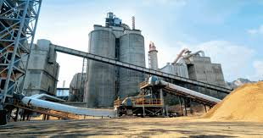

DEPENDENCE OF COMPRESSIVE STRENGTH ON VARIOUS INPUT FACTORS
OF CONCRETE FORMATION
ARIJIT NASKAR
PIYUSH SWARNKAR
ABHRADIPTA GHOSH
PRESENTED BY :

Slide 2

DATA DESCRIPTION
No. of Variables | No. of Observations
10 | 103
INPUT VARIABLES
INPUT VARIABLES
OUTPUT VARIABLES
Cement
Slag
Slump
Fly Ash
Flow
Water
SP
Compressive Strength
Fine Aggr.
Coarse Aggr.

Slide 3
NOTATIONS :
Y : Compressive Strength
x₁ : cement
x₂ : slag
x₃ : Fly ash
x₄ : Water
x₅ :SP
x₆ :CA
x₇ :FA

Slide 4

Goals of our study :
To evaluate empirically how Compressive Strength depends on the input variables.
To construct an appropriate model by method of regression.
Improvising the model based on the validity of the assumptions.
To fit an appropriate model to the data and draw inference.

Slide 5
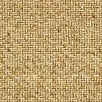
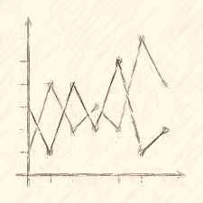
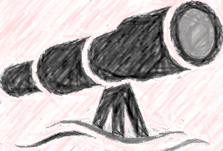
A BRIEF VISUAL REPRESENTATION OF THE VARIABLES AND THEIR RELATIONSHIP

Slide 6

Scatter Plot
Of
Compressive Strength
against
other Input Variables

Slide 9


We obtain the partial residual plots to visualize the
Relationship between Response and each input variable,
with reference to a linear model with all independent
variables.

Slide 12


WHAT MODEL TO START WITH ?

Slide 13


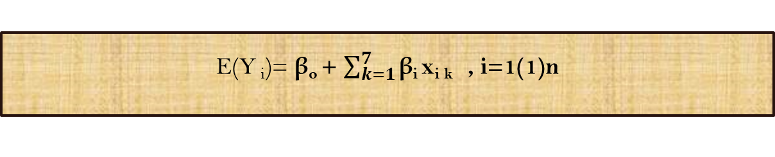
We observe a prevalent linear trend in the
Partial Residual plot as shown earlier.
Considering this pattern we start with a
Linear Model
E(Y _{i})= β_{o} + $\sum_{k=1}^{7}{\text{β}\text{i} }$x_{i k} , i=1(1)n

Slide 14

MODEL :
Y_{i} = β_{o} + $\sum_{k=1}^{7}{\text{β}\text{i} }$x_{ik} +ε_{i}
i=1(1)n
ASSUMPTIONS:
ε_{i} ‘s are homoscedastic.
ε_{i} ‘s are uncorrelated.
ε_{i} ‘s are Normally distributed.
X is non stochastic and of full rank

Slide 15

Now we follow some statistical methods to verify
If the assumptions are valid for our data

Slide 16
NORMALITY
1.
NORMAL PROBABILITY PLOT OF RESIDUALS
2.
SHAPIRO-WILK TEST

Slide 17
COMMENT : QUANTILES OF THE RESIDUALS RESEMBLE ALMOST CLOSELY TO THAT OF
A NORMAL DISTTRIBUTION . THERE ARE TRACES OF OUTLIERS IN THE PLOT.

Slide 18
COMMENT :The smooth curve closely resemble to a bell shape of Normal Distribution.

Slide 19
SHAPIRO-WILK TEST :
H_{o} : The residuals
are
Normally Distributed
vs.
H₁ : Not H_{o}
TEST-STATISTIC | p-value
0.97486 | 0.0467
COMMENT : The p-value is not too high to accept Null Hypothesis
Unambiguously.

Slide 20

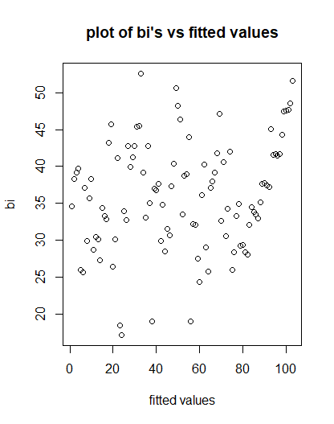
HOMOSCEDASTICITY
COMMENT :
We do not see any specific wedge-like pattern that can indicate presence of heteroscedasticity.

Slide 21
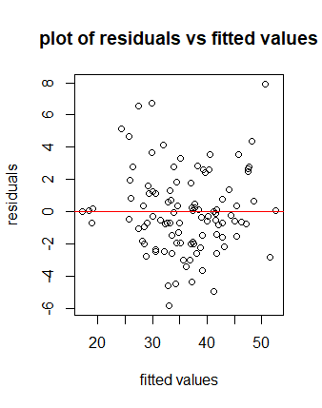
HOMOSCEDASTICITY
COMMENT :
The dispersion in the residuals do not increase or decrease significantly with fitted values.

Slide 22

HOMOSCEDASTICITY
STUDENTISED Breusch-Pagan Test and
Goldfeld-Quandt Test
H_{o} : The residuals
are
Homoscedastic
vs.
H₁ : Not H_{o}
 | Test Statistic | p-value
BP test | 8.791 | 0.268
GQ test | 0.7497 | 0.8279
Comment : The p-value is quite higher and hence we can accept
Null Hypothesis.

Slide 23
AUTOCORRELATION
1.
RESIDUAL PLOT
2.
DURBIN WATSON TEST

Slide 24
COMMENT : The pattern of positive or negative autocorrelation is not very consistent.

Slide 25
COMMENT : At lag 1 , no autocorrelation is significantly apparent from the plot

Slide 26
COMMENT : Also at lag 2 , no autocorrelation is significantly apparent from the plot

Slide 27
DURBIN WATSON TEST
H_{o} : ρ = 0 (ρ is the q^{th} order cc for residuals)
vs.
H₁ : Not H_{o}
DW Statistic | p-value | Lag
0.128 | 0.114 | 1
2.339 | 0.088 | 2
COMMENT : p-value is quite higher which gives evidence in favor of
the Null hypothesis.

Slide 28
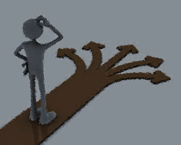
MULTICOLLINEARITY
1.
Pairwise Correlation
2.
VIF’s & Condition Number

Slide 29
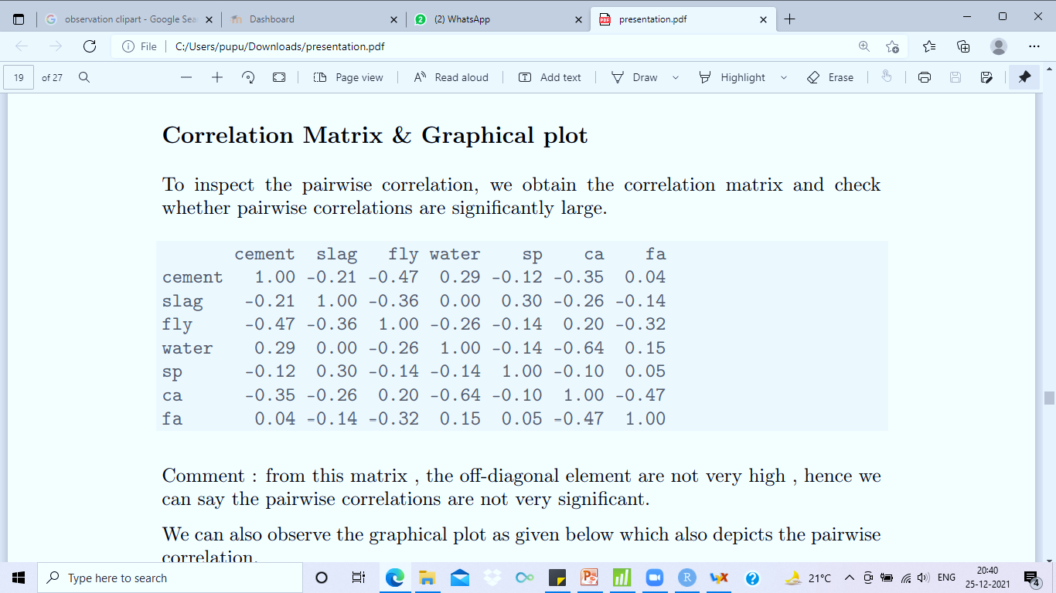

Slide 30
MULTICOLLINEARITY
Variables | CEMENT | SLAG | FLY ASH | WATER | SP | COARSE AGGR. | FINE AGGR
VIF | 46.41 | 53.3 | 57.89 | 27.17 | 2.15 | 86.9 | 46.8
COMMENT :
HIGH VALUE OF THE VIF’s AND HIGH CONDITION NUMBER INDICATES SHARPLY THE PRESENCE OF MULTICOLLINEARITY IN THE DATA.T
CONDITION NUMBER :
729

Slide 31
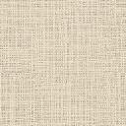

If we drop the variable Coarse Aggr. From Model….
We see the following changes------

Slide 32
MULTICOLLINEARITY
Variables | CEMENT | SLAG | FLY ASH | WATER | SP | FINE AGGR
VIF | 1.89 | 1.83 | 2.39 | 1.15 | 1.15 | 1.38
COMMENT :
CONDITION NUMBER AND THE VIF’s DECREASED TO A VERY HIGH EXTENT BY ELIMINATING THE COVARIATE COARSE AGGR.
CONDITION NUMBER :
8.7

Slide 33

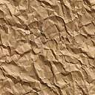

We observe that, there are no significant evidences against
all the previous assumptions but that of Normality, and
Multicollinearity.
We also obtain trace of outliers from the corresponding
plots.
We deal with the presence of influential points with more evident
techniques and check if the lack of Normality is still prominent or
induced by the influential points.

Slide 34
DETECTION OF INFLUENTIAL POINTS
DETECTION
SUITABLE
STATISTIC
VALUES
GRAPHICAL
DISPLAY

Slide 35
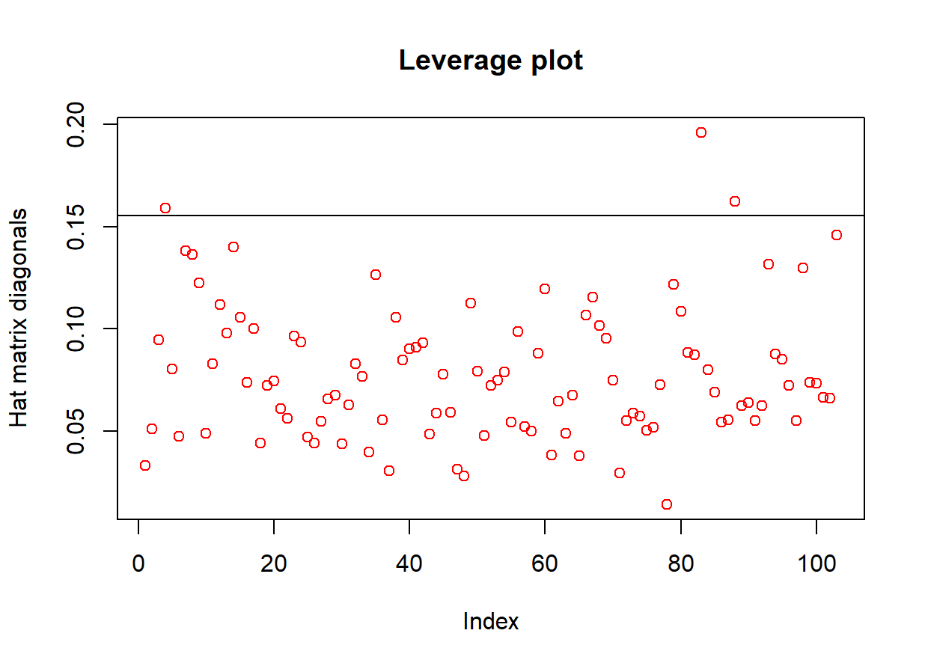
COMMENT : Taking (2p/n) as bound for the hat matrix diagonals we see that (4,83,88) th data points fall beyond the limits.

Slide 36
COMMENT : Taking (-2,2) as a normative bound for the externally studentized residuals
we see that (8,14,22,49,60,87)th data points fall beyond the limits.

Slide 37
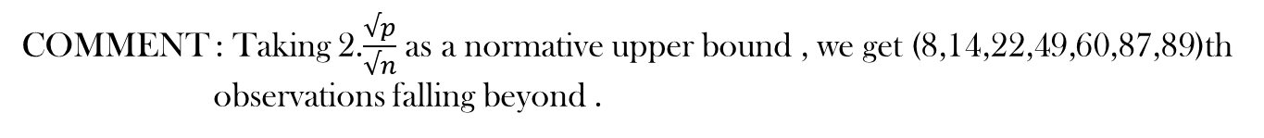
COMMENT : Taking 2.$\frac{√p}{√n}$ as a normative upper bound , we get (8,14,22,49,60,87,89)th
observations falling beyond .

Slide 38
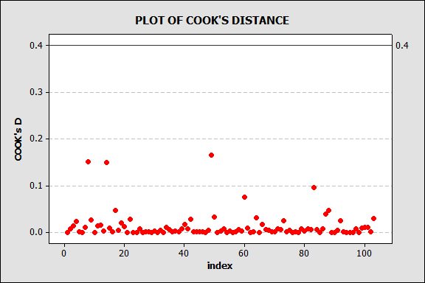
COMMENT : Taking F_{p,n-p,0.10} , 0.42 as a normative upper bound for the Cook’s D,
we see that all the points fall inside the limit.

Slide 39
COMMENT : Taking (1-3p/n , 1+3p/n) as a normative bound , we get
(8,14,22,49,87,96,97 )th observations falling beyond .

Slide 40
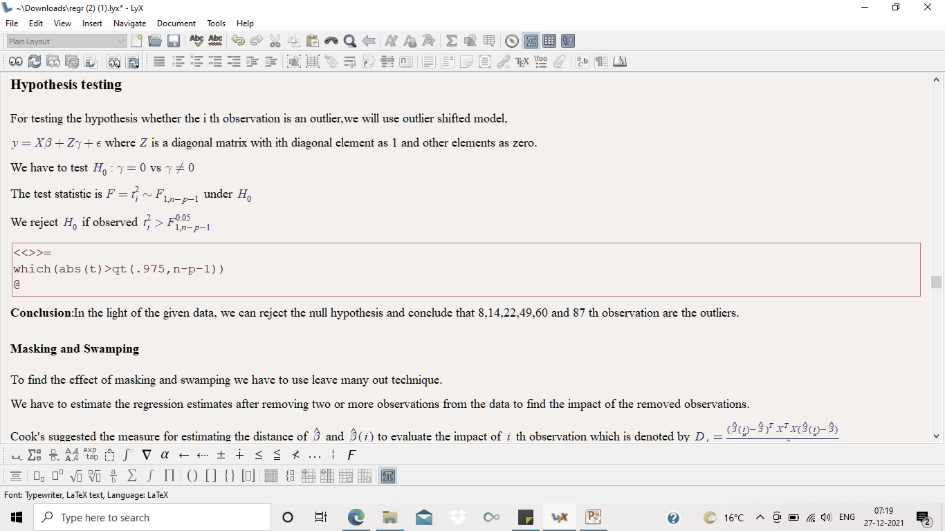
Conducting this test for all the suspected points, we get (8,12,22,49,60,87)th
observations as outliers

Slide 41
HOW TO DEAL WITH THE OUTLIERS AND
MULTICOLLINEARITY ?

Slide 42

Approach 1
We truncate the outliers and fit a suitable linear model
by Stepwise Regression & check whether severe
Multicollinearity still persists.
Approach 2
Without truncating the outliers, we opt the method of
Robust Regression.

Slide 43
Following Approach 1….
We truncate the detected influential points------

Slide 44

WHAT ABOUT THE ASSUMPTIONS NOW?
ARE THEY STILL VALID ??

Slide 45
NORMALITY
1.
NORMAL PROBABILITY PLOT OF RESIDUALS
2.
SHAPIRO-WILK TEST

Slide 46
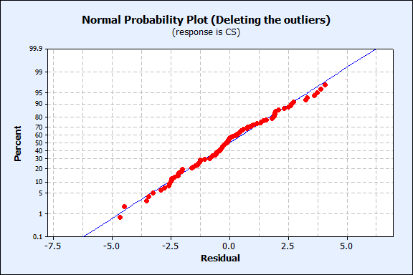
COMMENT : QUANTILES OF THE RESIDUALS RESEMBLE ALMOST CLOSELY TO THAT OF
A NORMAL DISTRIBUTION .

Slide 47
SHAPIRO-WILK TEST :
H_{o} : The residuals
are
Normally Distributed
vs.
H₁ : Not H_{o}
TEST-STATISTIC | p-value
0.99 | 0.6121
COMMENT : The p-value is high enough to accept Null Hypothesis .

Slide 48
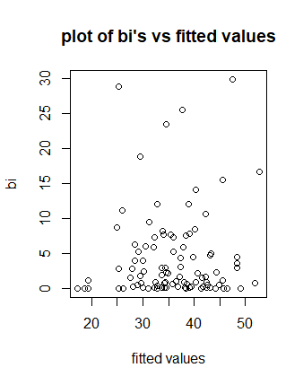
HOMOSCEDASTICITY
COMMENT :
We do not see any specific wedge-like pattern that can indicate presence of heteroscedasticity.

Slide 49
HOMOSCEDASTICITY
COMMENT :
The dispersion in the residuals do not increase or decrease significantly with fitted values.

Slide 50
HOMOSCEDASTICITY
STUDENTISED Breusch-Pagan Test
H_{o} : The residuals
are
Homoscedastic
vs.
H₁ : Not H_{o}
BP Statistic | p-value
5.0125 | 0.658
Comment : The p-value is quite higher and hence we can accept
Null Hypothesis.

Slide 51
AUTOCORRELATION
1.
RESIDUAL PLOT
2.
DURBIN WATSON TEST

Slide 52
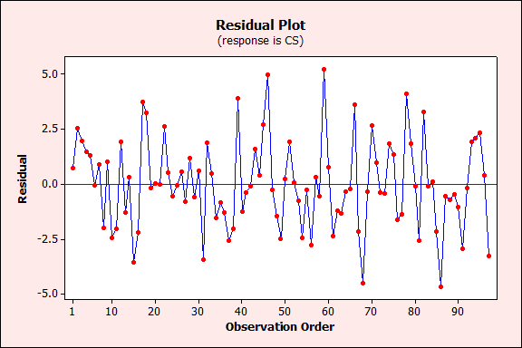
COMMENT : The pattern of positive or negative autocorrelation is not very consistent.

Slide 53
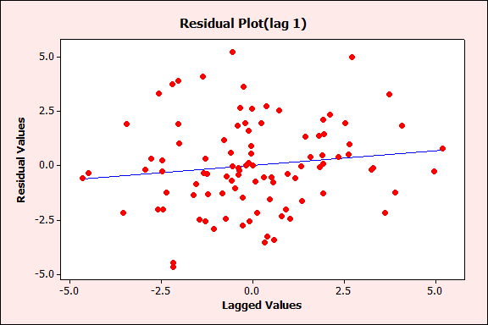
COMMENT : At lag 1 , no autocorrelation is significantly apparent from the plot

Slide 54
DURBIN WATSON TEST
H_{o} : ρ = 0 (ρ is the 1st order cc for
residuals)
vs.
H₁ : Not H_{o}
DW Statistic | p-value
0.131 | 0.084
COMMENT : p-value is quite higher which gives evidence in favor of
the Null hypothesis.

Slide 55


We see that after truncating the outliers,
all the assumptions seem to be more valid.
Although since data reduction can not resolve
Multicollinearity when number of variates
are same, so we do not further check for that
Assumption.
With the reduced data, now we would
opt the method of
Stepwise regression.

Slide 56
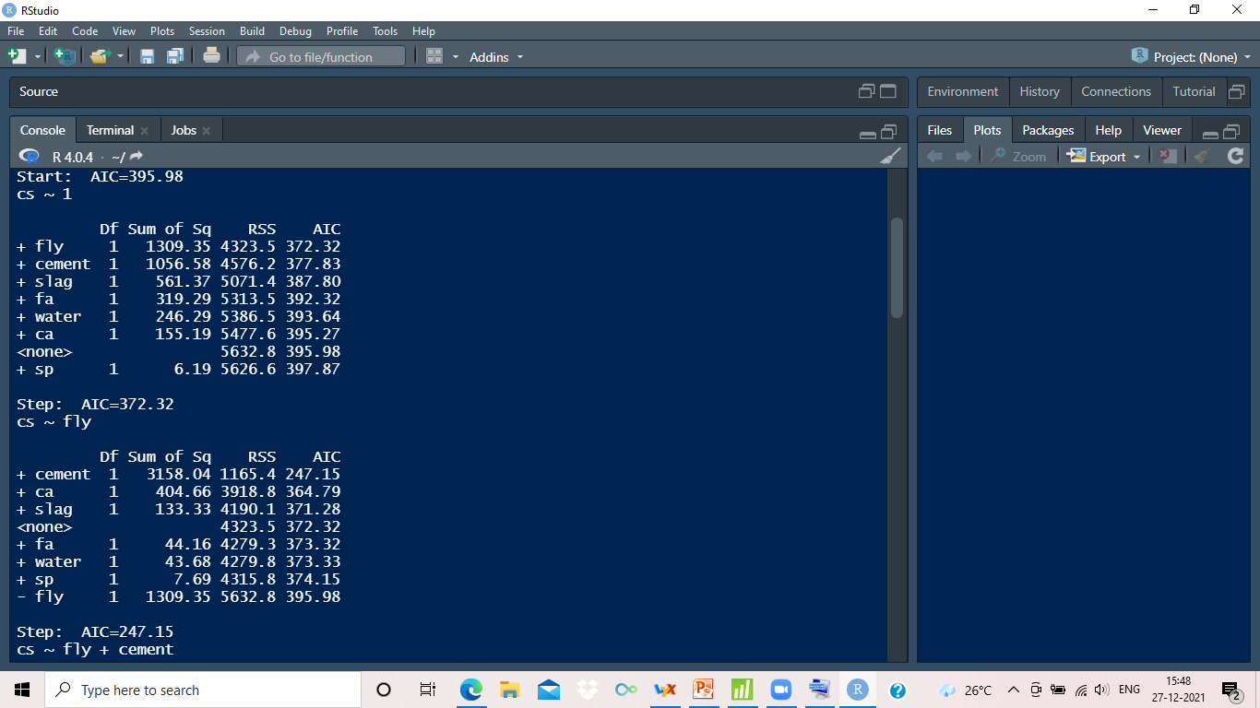
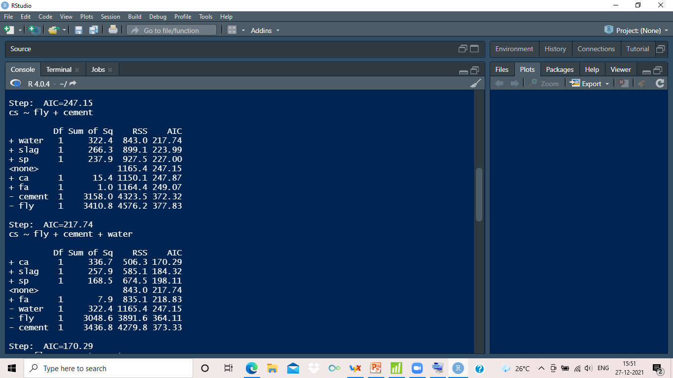

Slide 57
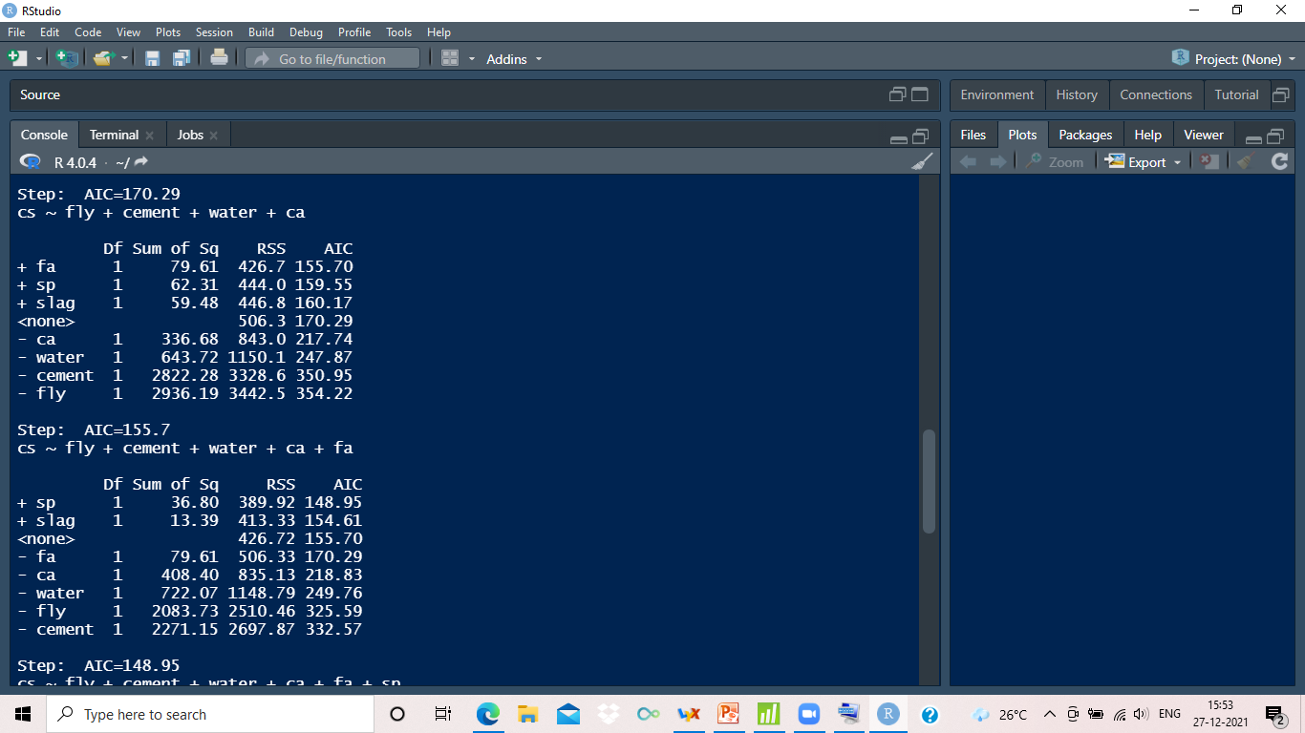
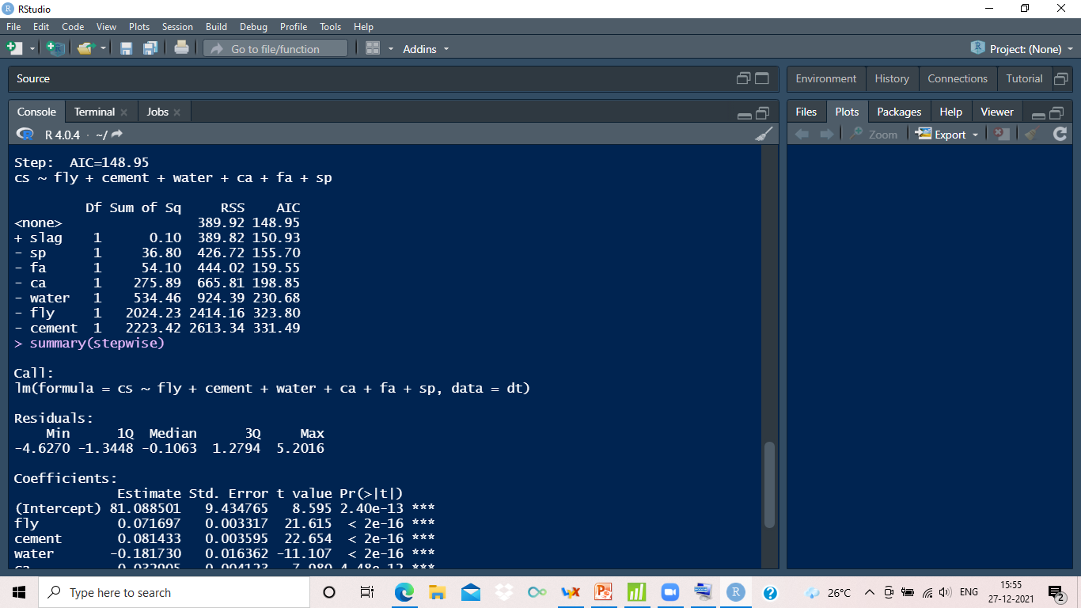

Slide 58
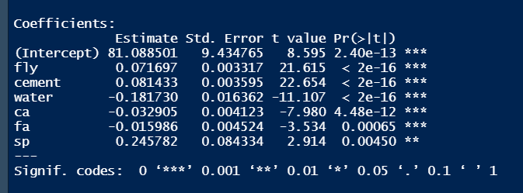

Fitted Regression Line
$\hat{Y\text{i}}$ = 81.09+0.07x _{i3} +0.08x _{i1} -0.18x _{i4}-0.033x _{i6} -0.016x _{i7}-0.025x _{i2 , i=1(1)n}
cv(1) : 7.51 , Adjusted R² = 0.93

Slide 60
WHAT ABOUT THE MULTICOLLINEARITY NOW??

Slide 61
MULTICOLLINEARITY
Variables | Fly | Cement | Water | Coarse Aggr. | FINE AGGR | SP
VIF | 1.79 | 1.73 | 2.15 | 2.97 | 1.75 | 1.26
COMMENT :
Although, Condition Number and VIF’s
are lesser than the former case, they are not too low to indicate presence of Multicollinearity.
CONDITION NUMBER :
16.63

Slide 62
The Stepwise regression method gives us
a model with lower cv but problem of
Multicollinearity is still not resolved
Completely.
With the reduced data, we again build a
Model based on Lasso Estimates, as an
alternative to the previous one, and make
a comparison.

Slide 63

LASSO REGRESSION
SSE is minimized subject to constraint $\sum_{i=1}^{n}{|β}$_{i}$|$ < s
SSE is minimized subject to constraint ∑24_(𝑖=1)^𝑛▒〖|𝛽〗_{i}| < s
This gives a good model under
Multicollinearity.
We take the tuning parameter as
K= 0.02912

Slide 64
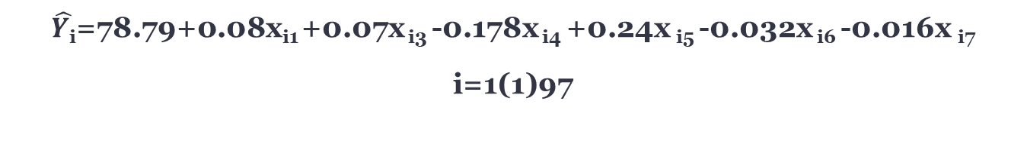
LASSO REGRESSION
FITTED REGRESSION EQUATION :
$\hat{Y\text{i}}$=78.79+0.08x_{i1} +0.07x _{i3} -0.178x _{i4} +0.24x _{i5} -0.032x _{i6} -0.016x _{i7}
i=1(1)97
The cross validation error of this model is given by 4.726

Slide 65
COMMENT : Apparently the original and fitted values lie very close to
each other.

Slide 66

NOW , WE GO FOR A ROBUST REGRESSION METHOD , FOLLOWING APPROACH 2.

Slide 67
ROBUST REGRESSION
Coefficients are obtained by minimising median_{i} e_{i}(β)² (LMS)
Measures are less affected by the presence of outliers.
Breakdown point is almost 0.5.

Slide 68
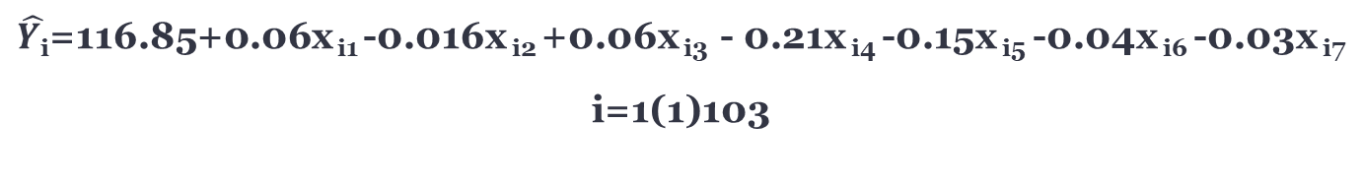
ROBUST REGRESSION
FITTED REGRESSION EQUATION :
$\hat{Y\text{i}}$=116.85+0.06x _{i1} -0.016x _{i2} +0.06x _{i3} - 0.21x _{i4} -0.15x _{i5} -0.04x _{i6} -0.03x _{i7}
i=1(1)103
The cross validation (scaled) error of this model came out to be very high (~3781.84)

Slide 69
COMMENT : At few data points, the fitted and observed values are
considerably distant.

Slide 70

WHICH MODEL DO WE CHOOSE
NOW?

Slide 71

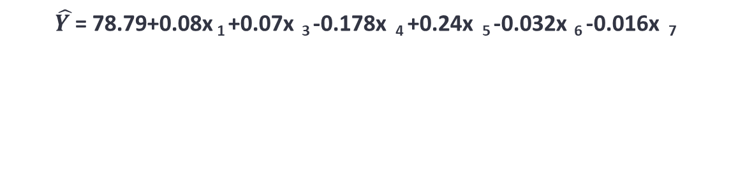
Based on the cv(1) values ,
We choose the Lasso model as the most suitable model
For our data.
$\hat{Y }$= 78.79+0.08x ₁ +0.07x ₃ -0.178x ₄ +0.24x ₅ -0.032x ₆ -0.016x ₇
FINAL MODEL

